Slide 1
ETD Database
Its Design and Development using Greenstone Digital Library Software
Exclusively For The Department Of Library And Information Science, Pondicherry University.

Slide 2
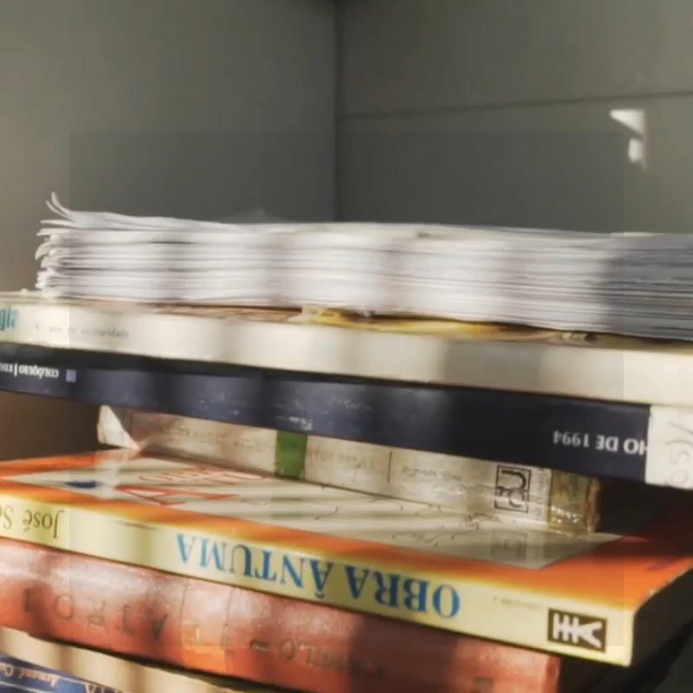

“DESIGN AND DEVELOPMENT OF ELECTRONIC THESIS AND DISSERTATION DATABASE FOR DLIS, PU USING GREENSTONE DIGITAL LIBRARY SOFTWARE”
By
ANNA POORANI V.
(18390003)
2nd M.Lib.I.Sc.,
Department of Library & Information Science
Supervised By
Dr. M. LEELADHARAN
Assistant Professor
Department of Library and Information Science
School of Media & Mass Communication
Pondicherry University

Slide 3
INTRODUCTION
01
LITERATURE REVIEW
02
DESIGN & DEVELOPMENT
METHODOLOGY
TABLE OF CONTENTS
04
03
EVALUATION
05
CONCLUSION
06
Research Problem, Definitions, Aim & Objectives, Scope
Review of past researches done under the themes
Process of design, development and implementation of ETD
Methods adopted in the development of ETD
Formative and Summative Evaluation of ETD
Contributions, limitations, Further Recommendations, Conclusion

Slide 4
01
INTRODUCTION
Research Problem, Definitions, Aim & Objectives, Scope

Slide 5
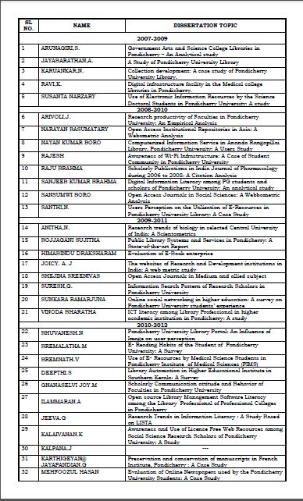
RESEARCH PROBLEM
Existing Data System
Data Insufficiency
Neither a semantic structure
Manual Browsing
Laborious Task
Time Consuming
Unpreserved of Primary Data
Restricted Access
Limited usage of Intellectual Output

Slide 6
Digital Library
Institutional Repository
ETD Database
“Digital collections capturing and preserving the
intellectual output of a single or multi-university community”
"a focused collection of digital objects, along with
methods for access and retrieval, and for selection, organization, and maintenance of the collection”
- Ian Witten and David Bainbridge
“an electronic system that captures preserves and
provides access to Digital collections of Thesis and Dissertation Metadata along with Bibliographic data”

Slide 7
AIM
The aim of this project is to develop an
“Electronic Thesis and Dissertation Database”
Using Greenstone Digital Library Software
for the Department of Library and Information Science, Pondicherry University”.

Slide 8
PURPOSE
The purpose of this project is to understand the process of non-commercial mechanism for
digitization and management of intellectual output of the Department of Library and Information Science, Pondicherry University.

Slide 9
OBJECTIVES
DIGITIZE
CATEGORIZE
DEVISE
The Specific Objectives that guided the study are as follows.
To categorize the intellectual materials that are digitized.
To digitize the physical collection of Thesis and Dissertation of DLIS, PU.
To devise E-Thesis and Dissertation (ETD) database.

Slide 10
Scope
Common User Interface
Bibliographic Searching
Browsing Facility
Dynamic Updation
Global Access
Secure Primary Data

Slide 11
02
LITERATURE REVIEW
Review of past researches done under the themes

Slide 12
Review of Literature
More than 101 articles, dissertations, book chapters, webpages were collected in the concerned themes of the study, of which 31 articles were opt for review.
Review was conducted in the literature of different facets of the dissertations: DL, IR, ETD, Workflow, Standards, OSS, GSDL.
Different trials in the design and development process were out looked in the perspective of resources available, existing potential, research gaps, limitations, justifications made.
The process of review is being carried out rationally.
The literature search has consulted resources like full text data bases, journals, reports and books.

Slide 13
Justification for the selection of GSDL
Features | DSpace | Greenstone | EPrints
Open Source | Yes | Yes | Yes
Unicode Compliant | Yes | Yes | Yes
Language Interface | No | Yes | No
Built in HTML viewers | No | Yes | No
Size | 6 MB | 69.7 MB | 2 MB
Server | UNIX/Windows | UNIX/Windows | UNIX
Offline Viewing/Browsing | No | Yes | No

Slide 14
03
Methodology
Methods adopted in the development of ETD

Slide 15
ADDIE Model
ANALYSIS
DESIGN
DEVELOPMENT
IMPLEMENTATION
EVALUATION
User Analysis
Objective Analysis
Structure Analysis
Creating Workflow.
Selection of Digital Library Platform.
Evaluation Design.
Prototype Creation
Metadata Extraction
Prototype Valuation
Database Creation
UI Customization
Formative Evaluation
Summative Evaluation

Slide 16
04
DESIGN & DEVELOPMENT
Process of design, development and implementation of ETD

Slide 17
Design and Development
Devising Database
Using GSDL
ETD Database
The Design and Development of ETD database includes 3 phases
Data Creation
Digitising Collection
Extracting Metadata
Data Processing
Creating DO
Indexing
Cataloging

Slide 18
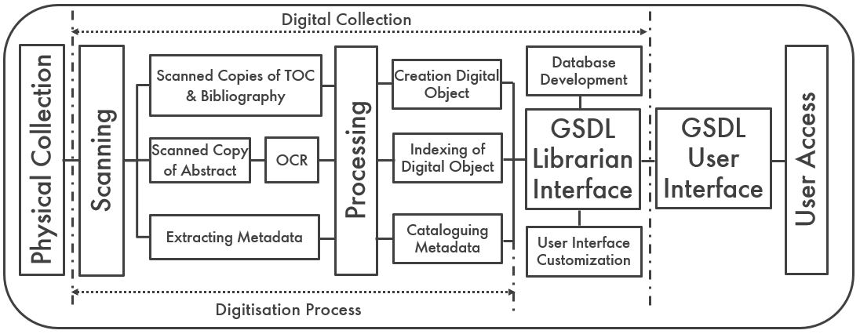
Workflow

Slide 19
Data Creation
Digitizing the Collection
Extracting Metadata
“Digitization is the process of renovating the content in the physical media
to the digital media.”
Metadata components, manually extracted from the physical collection of Thesis
and Dissertation were recorded in the Excel Sheets.

Slide 20
Process of Digitization

Slide 21
Data Processing
Creating Digital Object
Indexing Digital Object
Cataloguing Metadata
The Processed PDF Documents were assigned of primary metadata (reg. no.) before being imported to GSDL librarian interface
The captured images of the Thesis and Dissertation were processed and converted into PDF Documents
The metadata elements recorded in the Excel sheets the were moved into the GSDL librarian interface in CSV format as null records.
Later these null records were mapped to their corresponding DO

Slide 22
Mapping of DC.Metadata
Archive File | Dublin Core Metadata
Title | dc.Title
Area of Study | dc.Subject
Abstract | dc.Description
Year of Submission | dc.Date
Registration Number | dc.Type
Record Number | dc.Identifier
Source | dc.Source
Dissertation/Thesis | dc.Format
Author | dc.Creator
Guide | dc.Contributor
 | dc.Publisher
 | dc.Language
 | dc.Relation
Key words | dc.Coverage
 | dc.Rights

Slide 23
Devising the Database
using Greenstone Digital Library Software
To catalogue documents with metadata
To Customiste the pae display
Enrich
Format
Gather
Design
Create
To collect the required documents by exploring the Local File space
To Plan the features reqiured
To Build and Preview the Collection

Slide 24
Preview of ETD Database
Electronic Thesis and Dissertation Database

Slide 25
05
EVALUATION
Formative and Summative Evaluation of ETD

Slide 26
CUSTOMER REVIEWS
Formative Evaluation
Summative Evaluation
“assessment conducted during the development process in order to alter prototype to robustness!”
“assessment conducted at the end of development, to ensure to what extent the
intended objectives have been accomplished.”

Slide 27
Formative Evaluation
S.No. | Lapse/Error | Response
1 | Simple Search Index | Advanced Sorting and Filtering Options
2 | Exhaustive Listing of Records | Classified Browsing Index
3 | Listing of Classified Documents | Supplemented with Number of Records
4 | Visual Noise | Personalized Home and Browsing pages
5 | Fixed Navigation Bar | Customization of Navigation bar
6 | Default Banner | Redesigned Banner for ETD Database
7 | Conventional Greenstone Icons | Custom Icons

Slide 28
Heuristic Evaluation
Summative Evaluation
“A heuristic evaluation is the systematic inspection of a user interface
design, based on interface design guidelines and principles. It specifically involves
evaluators examining the interface and judging its compliance with recognized usability
principles (the heuristics).”
The Heuristic Evaluation was performed in 2 steps
1. Choosing the Heuristic Guideline (Jakob Nielsen's 10 General Principles For Interaction Design)
2. Define a Ranking System (Binary Ranking System)

Slide 29
S.No. | Usability Heuristics | Binary Ranking
1 | Visibility of system status | No
2 | Match between system and the real world | Yes
3 | User control and freedom | Yes
4 | Consistency and standards | Yes
5 | Error prevention | No
6 | Recognition rather than recall | Yes
7 | Flexibility and efficiency of use | No
8 | Aesthetic and minimalist design | Yes
9 | Help users recognize, diagnose, and recover from errors | No
10 | Help and documentation | Yes

Slide 30
06
CONCLUSION
Contributions, limitations, Further Recommendations, Conclusion

Slide 31
Research Contributions
1
2
The core contribution of the project is to create an Electronic Thesis and Dissertation Database. The subventions of the present dissertation work include
Digitalized the physical collection of Thesis and Dissertation
Gathered Metadata of Thesis and Dissertation Collection.
3
Finding useful features of Open Source Digital Library software.
4
Explored different components of Greenstone Digital library software
5
Customized Greenstone Macros

Slide 32
Infograpics
205
9
196
Total Number of Records
6
PDF’s couldn’t be Processed
Missing Dissertations
Records in the Collection

Slide 33
Limitations of Research
The Digitization of Thesis
Standardization of Nomenclature for Subject Headings
Real Time Evaluation of the Database by the Experts
Individual PDF Copies of Abstract, TOC, Bibliography Under Same Record.
Greenstone Digital Library Software Version 3.09

Slide 34
Recommendation for Future Research
To extend the ETD Database as a full scale digital library with reference ebooks, question bank, faculty profile, faculty publications, photo exhibition…
To stretch out the ETD Database with years to come.
To explore Greenstone digital library software more and more.
To develop collection of records with multiple document types can still be explored.
To further the work study on Greenstone Digital Library Software Version 3.09.
To study the User experience on the database, and their feedback can be used for improving and customizing the macros to attain robustness in the ETD collection and user friendliness in accessing the ETD Database.
To conduct a Bibliometric analysis on the metadata gathered.

Slide 35
Conclusion
Pros
Cons
Digital services are more Economic
Helpful to preserve primary hardcopy
Inculcates fluency of using e-services
Accessibility for all students and staff.
Funding
Proprietorship & Licensing
Integrity of the scholarly work
This project brought forth the edges of developing a digital library collection of Electronic
Thesis and Dissertations using greenstone digital library software
Looking ahead, This ETD Database shall serve as a handy tool in preserving as well exploiting the
scholarly output of the Department of Library and Information Science, Pondicherry University

Slide 36

THANKS
annapoorani1094@gmail.com
+91 8903109410

